Slide 1
Unit -1
Presentation by
Anshu Singh

Slide 2
Flow of communication/channels of communication
An organization is a group of people associated for business, political, professional, religious, social,
or other purposes. Its activities require human beings to interact and react, that is, to communicate.
They exchange information, ideas, plans, order needed supplies and make decisions, rules,
proposals, contracts, and agreements. All these activities require one skill, that is communication.
So we can say that communication is the "Lifeline" of every organization
An exchange of information within an organization is called internal communication. It takes place
at different levels -- downwards, upwards and horizontal
To exchange information within and outside the organization we use a variety of formal and
informal forms of communication that carry the flow of information

Slide 3
Channels of Communication
Flow of Communication
Formal
Upward
Downward
Informal
Grapevine
horizontal
Diagonal

Slide 4
Downward Communication:
Downward communication refers to the communication from the higher level in in managerial hierarchy to the lower ones. It is a communication from decision makers to the workers. It is a communication from seniors to their subordinate employees.
The main function of downward communication is providing direction and control. It involves the transfer of information, instruction, advice, request, feedback and ideas to the subordinate staff. It increases staff awareness and facilitates implementation
New policies
Guidelines
Decisions
Evaluations
Appraisal

Slide 5
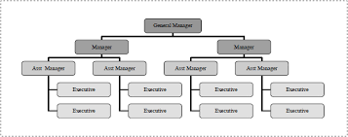
Examples of Downward Communication:
A communication from General Manager of a company to the branch managers is an example of downward communication.

Slide 6
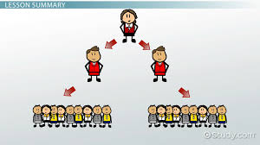

Slide 7
Forms of downward communication may include
Notes
▪ Notices
▪ Memos
▪ Telephone conversations
▪ Voice mails
▪ Emails
▪ Face to face conversations
Too much down ward communication may lead to reaction from subordinates and can hamper
better employee - employer relationship.

Slide 8
Upward Communication
This type of communication refers to-
Communication from subordinates to superiors
Communication from employees to management.
Communication from workers to decision makers
Since upward communication involves the transfer of – information, request and feedback from subordinates to their seniors, it promotes better working relationships within an organization by giving the subordinate staff opportunities to share their views and ideas with their supervisors. It facilitates employee involvement in the decision making process.

Slide 9
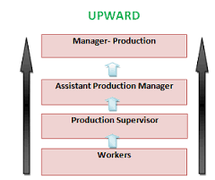

Slide 10
Examples of Upward Communication:
A business report from the branch manager of a company to the managing director of the company is an example of upward communication.
Other examples of upward communication include –
Business proposals
Suggestion box
Exit interviews

Slide 11
Horizontal or Lateral or Peer Group Communication
It takes place between professional peer groups or people working on the same level of hierarchy.
It is the communication among workers at the same level
The main objectives of horizontal communication are
Developing teamwork
Promoting group coordination within an organization

Slide 12
Horizontal or Lateral or Peer Group Communication
Horizontal communication is less formal and structured than both downward and upward communication and may be carried out through
Informal discussions
Management gossip
Telephone calls
Teleconferencing
Memos
Routine meetings

Slide 13
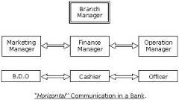

Slide 14
Diagonal or Cross-wise Communication
It is the product of modern changes in information technology and management. It is basically a response to market needs that demand speed and efficiency.
Diagonal communication flows in all directions. As the diagonal channel occurs between people who do not have to follow rigid norms of communication protocol

Slide 15
Grapevine Communication
If communication is done without maintaining the formalities prescribed by the organization, it is called informal communication.
The basis of informal communication is personal or informal relationship between the members of a group.
It is also known as grapevine that takes place when the people of an organization or group, especially of same level or rank gather or meet tighter and discuss informally.

Slide 16
Grapevine Communication
According to Bovee and Others, “Grapevine is an informal interpersonal channel of information not officially sanctioned by the organization.
Newstrom and K. Davis said, “Grapevine is an informal system that arises spontaneously from the social interaction of the organization.”
So, grapevine is an informal, unofficial and personal communication channel or system that takes place within the organization as a result of rumor and gossip. It is a complex web of oral information flow linking all the members of the organization.

Slide 17
Patterns or Types of Grapevine
Single Strand
Gossip Chain
Probability Chain
Cluster Chain

Slide 18

Single Strand Chain
The single strand chain involves the passing of information through a line of persons to the ultimate recipient. In the figure, the person A tells B, who tells C, who tells D, and so on, till the information has reached most of the persons involved or concerned.

Slide 19
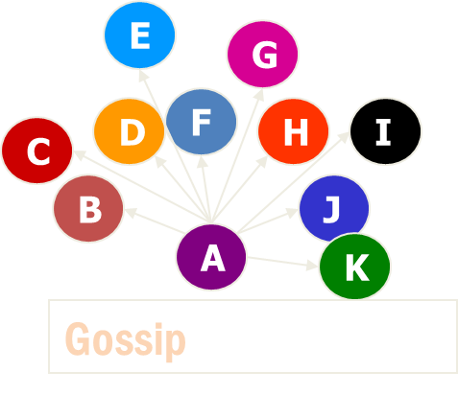
Gossip Chain
In the gossip chain, one person seeks and tells the information to everyone. This chain is just like the wheel where one person stays at the centre and the information passes along the spokes of the wheel to others stationed on the rim. In the following figure, A is at the center and passes the information to others staying on the rim of the wheel.

Slide 20
Probability Chain
The probability chain is a random process in which someone transmits the information to others in accordance with the laws of probability and then these others tell still others in a similar way. This chain may also be called random process.
E
C
K
H
G
I
X
F
B
D
J
A
Probability

Slide 21
Cluster Chain
In the cluster chain, a person tells the information to the selected persons who may in turn relay (pass) the information to other selected persons. Most of the information communication follows this chain
J
B
I
D
C
F
Cluster
A

Slide 22
ADVANTAGES
Grapevine channels carry information rapidly.
Feedback obtained is quick
Serves as an emotional supportive value
The grapevine is a supplement
Creates a sense of unity among the employees

Slide 23
Difference between Technical and General writing
Technical Writing
General Writing
Definition: Technical writing consists of reports, letters, papers, proposals, articles, thesis and some other writings which are popular among the professionals such as doctors, engineers, scientists and the researchers.
Reply: In technical writing a reply is expected from the reader.
Literary and other type of writings such as essays, poems, novels, stories etc. are known as general writings.
In general writing reader does not send a reply to the writer

Slide 24
Difference between Technical and General writing
Technical Writing
General Writing
Purpose: Technical writing aims at imparting information, instructions and explanations.
Style: Style of technical writing is impersonal and objective.
Style of technical writing is accurate and precise
General writing aims at amusing, entertaining and inspiring the readers
Style of general writing is personal and subjective
Style of general writing is poetic, decorative and bombastic (language that sounds impressive but has little meaning).

Slide 25
Difference between Technical and General writing
Technical Writing
General Writing
Nature: Technical writing is based on facts.
Language: Language of technical writing should be simple but effective.
General writing is highly imaginative
Language of general writing may be extravagant (exceeding the reasonable limit) and pompous (high opinion of own views).

Slide 26
Difference between Technical and General writing
Technical Writing
General Writing
Use: Technical writing is used in business so it is related to some specific profession.
Vocabulary: In technical writing technical vocabulary is used
General writing is related to life in general or life as a whole.
In general writing general vocabulary is used.

Slide 27
Features of technical writing or Dos and Don’ts of Technical Writing
Use of familiar and easy words: Only familiar and easy words should be used, complicated words should be avoided.
Use of clear sentences: Simple sentence structure should be used. Normal word order of Subject – Verb – Object should be followed.
Use of sentences of moderate length. (12 to 25 words): Sentences of 12 to 25 words only should be used.
Use of active voice: Active voice should be used as it is easy to understand and emphasis is laid on the subject and not on the object.

Slide 28
Avoid redundant phrases (lengthy and incorrect expressions) and use concise word or phrase.
Avoid Repetition: Repetition should be avoided as it can mar the beauty of expression
Accuracy: Accuracy includes accuracy of information as well as accuracy of expression
Logical division of paragraphs: Paragraphs should be logically divided; as a paragraph should convey only a single idea. If there is more than one idea then write those many numbers of paragraphs.
Proper mechanical means to convey information: Select the most suitable technique to carry your message, e.g. – email, fax, courier, post etc.

Slide 29
Language As A Tool Of Communication

Slide 30
In order to express his ideas emphatically, man needs some common medium of expression.
Physical gestures or certain noises like crying in anger, weeping or laughing may help a person
to communicate some of his feelings, just as a little baby weeps when he is hungry. In both the
above examples communication takes place without words. But man needs some means of
linguistic communication in order to express his fine ideas and emotions.
Man invented language which helps him to communicate and converse with different
sorts of people. Today it has become an important tool of socialization as well as of trade and
commerce.
Communication is the soul of our life. We need it to survive and effective communication is
made possible with the help of language. Language employs a combination of words to
communicate ideas in a meaningful way.

Slide 31
Characteristics of Language.
Language is used as a tool for communication because of certain characteristics which it posses.

Slide 32
Language is Arbitrary
Language is Artificial
Language is Restricted
Language is Abstract
Language is Recursive
Language is Social
Displacement

Slide 33
Language is Arbitrary (Illogical or random)
Language is arbitrary (illogical) in the sense that there is no inherent relation between the words of a language and their meanings or the ideas conveyed by them. There is no reason why a female adult human being be called a woman in English, aurat in Urdu, Zen in Persian and Femine in French. The choice of a word selected to mean a particular thing or idea is purely arbitrary but once a word is selected for a particular reference, it comes to stay as such. It may be noted that had language not been arbitrary, there would have been only one language in the world.

Slide 34
Language is Artificial (Manmade)
Language is created by people. It did not exist in isolation or outside the minds of people. It is
created by humans based on their needs.
Language is Restricted (limitations)
When we think and translate our thoughts into language, some meaning is lost in the process.
No symbol or word can transmit our exact perception. Language has its limitations.
Language is Abstract (conceptual):
Language is abstract because it represents generalized ideas of things or thoughts. A word could
represent different ideas at different times. A ‘table’ can be of different shapes and sizes, and still
be a table. Even if you have never seen a table with three legs, you can still identify it as a table.
This happens because the meaning gets associated with symbols and users keep expanding the
range of meaning.

Slide 35
Language is Recursive:
Recursion is the characteristics of language which enables one to generate any number of
sentences using the same grammatical pattern. It also allows one to express any idea, thought or
feeling using the same finite vocabulary.
Language is Social:
Language is a set of conventional communicative signals used by humans for communication in
a community. Language in this sense is a possession of a social group, comprising an
indispensable set of rules which permits its members to relate to each other, to interact with each
other, to co-operate with each other; it is a social institution. Language exists in society; it is a
means of nourishing and developing culture and establishing human relations.
Displacement
- This means that the speaker can talk about things which are not present, either spatially or
temporally. For example, human language allows speakers to talk about the past and the future,
as well as the present. Speakers can also talk about things that are physically distant (such as
other countries, the moon, etc.). They can even refer to things and events that do not actually
exist (they are not present in reality) such as the Easter Bunny, the Earth having an emperor, etc.

